Slide 1




JOURNEY TO YOUR BEST
TOP-DOWN APPROACH PRESENTATION
PRESENTED BY
Vũ Duy Dũng

Slide 2
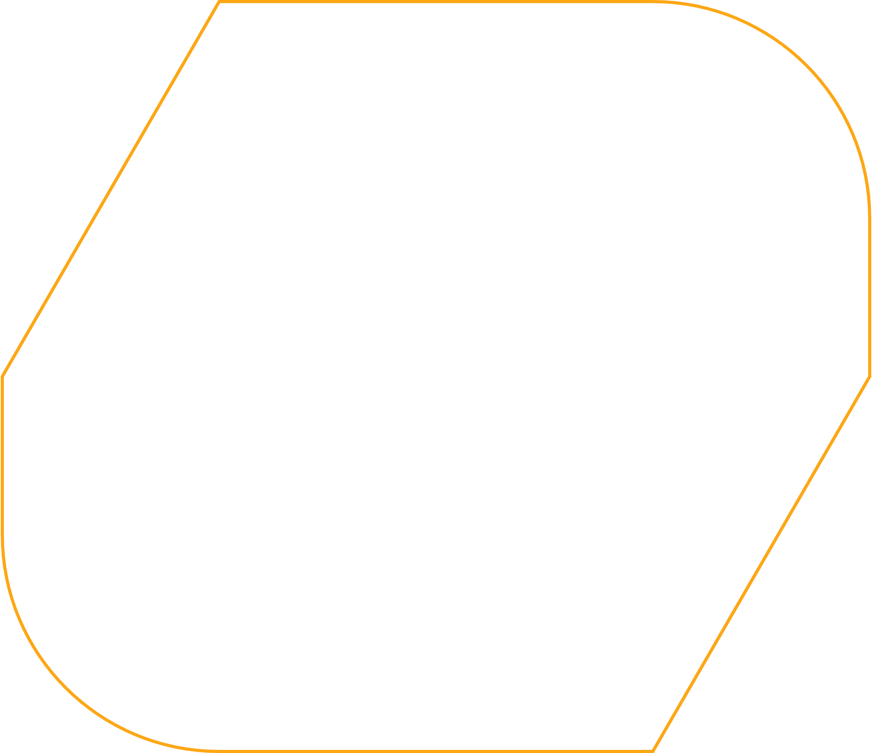
1 | Introduction
2 | How it works
3 | Benefits
4 | Notes
5 | How to apply on program
CONTENTS

Slide 3

INTRODUCTION
A problem-solving, design methodology
Top to down, general to detail
Divide and conquer
Apply in many fields
Used by many companies
Back to contents
03

Slide 4

HOW IT WORKS
Start with big picture
Define Major Components
Hierarchy of Detail
Implement and Integration
Back to contents
04

Slide 5

HOW IT WORKS
Big picture
Component
Component
Sub-component
Sub-component
Sub-component
Sub-component
Sub-component
Back to contents
05

Slide 6
BENEFITS
Back to contents
Clarity
Organized
Efficient
Simple
Comprehensive understanding of the overall
Easier to plan and execute tasks in a structured manner
Concentrate on key factors, avoid wasting time
Simplifies complex projects by breaking them down
06

Slide 7
NOTES
THE KEY
Defining the goal is the most important The hierarchy structure will determine performance
Back to contents
07

Slide 8
NOTES
HOW TO USE EFFECTIVELY
Thorough Research Discuss with Stakeholders Smart question Synthesize and Create a Comprehensive Vision Repeat
Back to contents
08

Slide 9
HOW TO APPLY ON PROGRAM
Follow up mentor requirement
Use smart questions
Use AI and support tools ( Chat GPT, Copilot, XMind...)
Practice breaking down problems in work and life
Exercise more and optimize to find your best
Back to contents
09

Slide 10
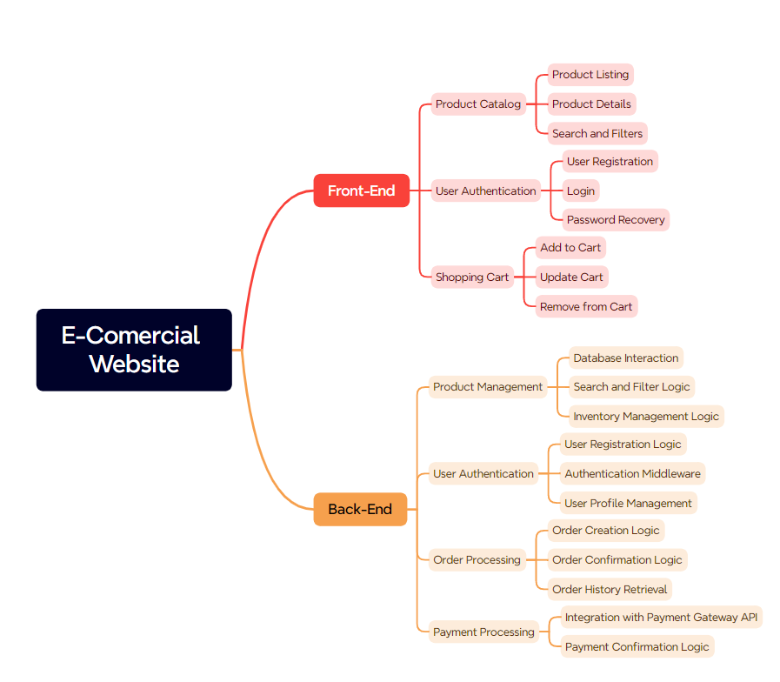
EXAMPLE
Back to contents
10

